Slide 1
IP cookie map study
2019 Jul

Slide 2
Sparse cookies / IPs
A more prevalant issue?

Slide 3
How many cookies per IP?
As we increase lookback window, the cookie per IP number increases
Regardless of lookback window, the % of IPs with only 1 cookie/DID is about the same: 25%
What could be the reason of that 25%?
Random cookies
Random IPs

Slide 4
Preliminary comparison with Vizio valid IPs
Vizio Ips are good quality in the sense that they are all cable providers
IPs in Adobe universe has many more IPs with only 1 cookie/DID
Why the difference?
More random IPs as Vizio valid IPs excluded non-ISP IPs and some dynamic IPs

Slide 5
Duration of IP cookie relationship
75% of IP cookie relationship, only show up in Adobe Ad cloud one day
Another 10% only show up 2 days
What could be the reasons?
Random cookies
Random IPs

Slide 6
Why so many sparse cookies/IPs?
https://www.mediapost.com/publications/article/316757/64-of-tracking-cookies-are-blocked-deleted-by-we.html
“64% of their tracking cookies were either blocked or deleted by web browsers. The rejection rate on mobile devices was higher -- at 75%, compared with 41% on desktop”
https://www.mobilemarketer.com/ex/mobilemarketer/cms/opinion/columns/12660.html
“If you are a simple meat-and-potatoes HTML page or even a fancy one with some JavaScript, you just cannot get the UDID of the device you are being shown on.”
Mobile ads/conversion still use cookies unless campaign/conversion happen in app.
https://www.zdnet.com/article/ios-11-rolls-out-today-with-safari-anti-tracking-heres-why-advertisers-hate-it/
“Safari already blocks third-party cookies, but ITP will delete first-party cookies too if the user hasn't interacted with the site in the past 30 days. ”
https://whatismyipaddress.com/keeps-changing
“Dynamic IP addresses make it easier for your ISP if you're an ordinary computer user.”

Slide 7
Too many cookies per IP?
The other side of the problem

Slide 8
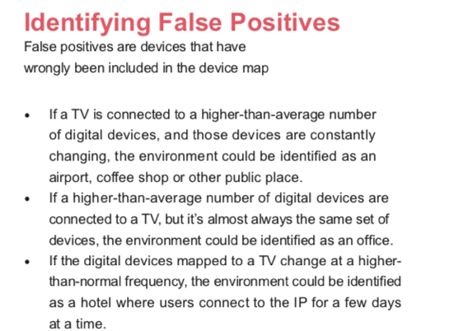
Why so many cookies
Business
Ad server IPs
Dynamic IPs assigned to multiple users

Slide 9
Our Methodology
Prediction model
Notes:
159,210,217 IPs to start with → 122,127,384 after modeling → 116,372,223 after cookie/did per IP cutoff → 114,996,037 after IP per cookie cutoff

Slide 10
Methodology overview
Model
TV IDs as a static ID can help us define whether an IP is static HH or not
Use IPs associated with TV IDs to build a predictive model that achieves over 90% accuracy, precision and recall
Use the model to predict if digital IPs is static or dynamic
Use case
HH level device graph
Retargeting
Cross channel planning and measurement

Slide 11
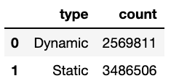
Dependent Variables – Dynamic v.s. Static
Use TV_IDs that are present long enough in past 2 months *
Group TVs together if they are linked by Ips. All the IPs that are linked to those TVs are grouped together as well.
If a group has only 1 IP, then we consider it’s static HHs.
If a group has >=10 IPs, we consider it’s not static HHs.
* Watch TV for >=10 days; or time span between latest and earliest tune-in is >= 20 days;
That is about 80% of the TVs

Slide 12
Dependent Variables – Dynamic v.s. Static
Static IPs on average have less cookies and device IDs
Static IPs are matched to cookies that are associated with less IPs

Slide 13
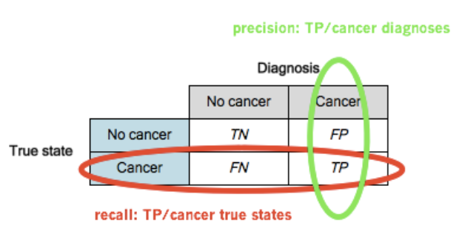
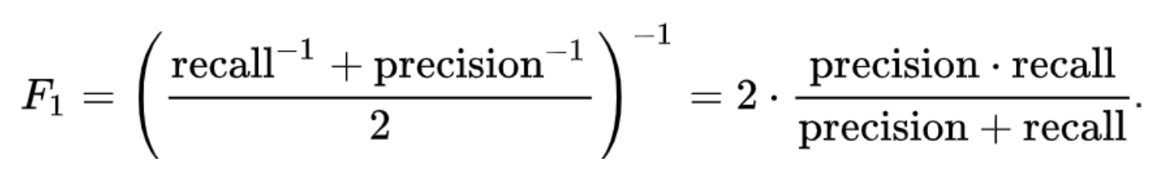
Prediction Model evaluation

Slide 14
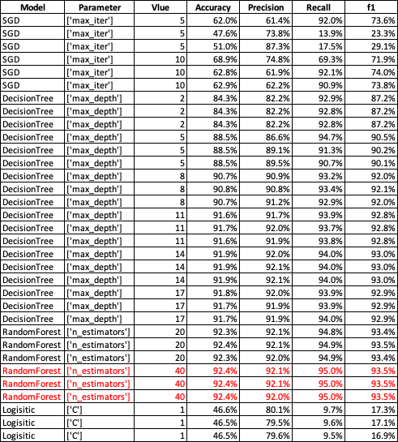
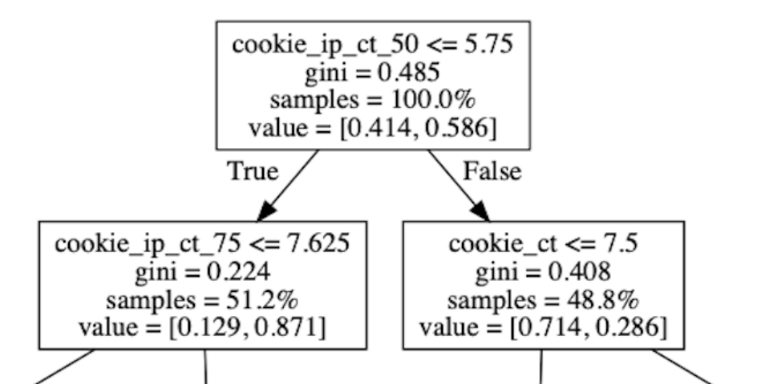
Model selection – v2
Accuracy: 92% prediction is accurate.
Precision: 92% are static among all predicted so.
Recall: 95% static HHs are predicted so.
F1: 93%

Slide 15
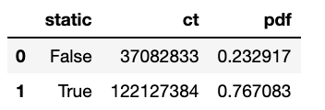
Model prediction
About 77% IPs are predicted to be static HHs.
IPs that are predicted as static HHs have many more IPs with smaller amount of cookies.
Both good and bad IPs have significant portion that has high # of cookie+DIDs. The traditional cutoff approach will probably keep a significant amount of bad IPs and throw out a good amount of good IPs.
Notes:
% of IPs with only 1 DID/cookies has been brought down from 25% to 14%.

Slide 16
Further cleanup – cookie/DID per IP cutoff
Issues still:
There are still IPs predicted to be static HHs that have number of cookies+DIDs more than common sense will suggest.
IPs with only 1 cookie/DID drop from 25% to 20.5%.
1-day only IP-cookie pair relationship drop from 73% to 57%.
One more cleanup:
Drop IPs with more than 30 cookies. --> that is about 3.5% of IPs
Drop IPs with more than 20 DIDs --> that is about 1.8% of IPs
In total drop about 4.7% IPs

Slide 17
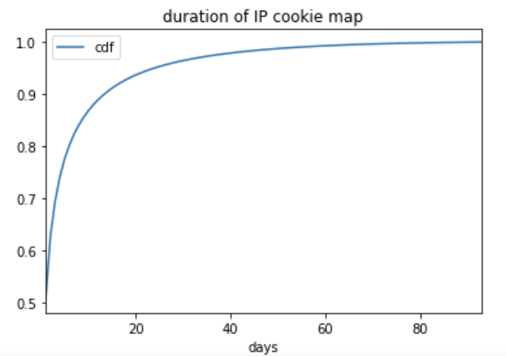
Further cleanup – IP per cookie/DID cutoff
% of IPs with only 1 cookie/DID stays at 21%.
1-day only IP-cookie pair relationship drop further to 50%.
99+% of cookies have <=4 IPs; 99+% of DIDs have <=3 Ips.
Drop cookies with >4 IPs; Drop DIDs with >3 IPs. That is 1.2% IPs.

Slide 18
IP cookie map flags
One day only relations flag: (days=1)
Needed days=1 for conversion
May make sense to drop days=1 for retargeting if cookie is short lived or cookie doesn’t show up in Ad cloud often enough?
Dominant IP for cookie relation: (rn=1)
For conversion especially PTV/CTV where exposure most likely happens at dominant IP, it may make sense to drop relations where cookie is mapped to an IP that is not dominant?

